Slide 1
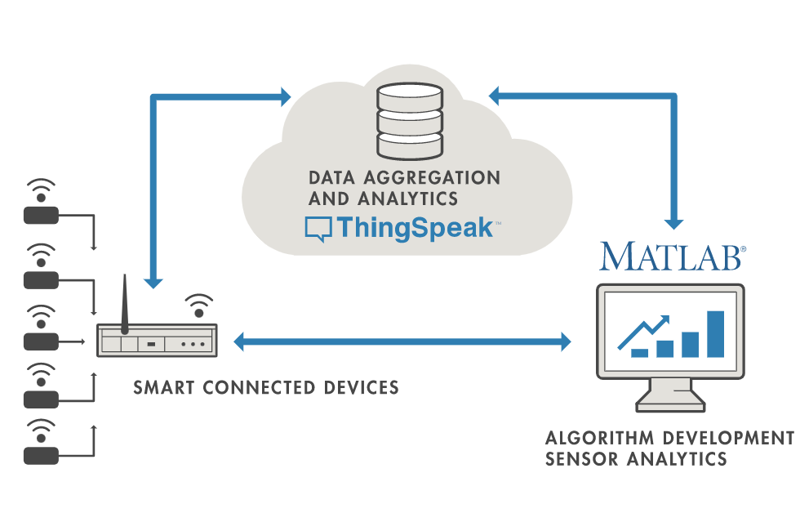
ThingSpeak

Slide 2
ThingSpeak
ThingSpeak is an open-source software written in Ruby which allows users to communicate with internet enabled devices.
ThingSpeak is a platform providing various services exclusively targeted for building IoT applications.
It offers the capabilities of real-time data collection, visualizing the collected data in the form of charts, ability to create plugins and apps for collaborating with web services, social network and other APIs.
ThingSpeak provides instant visualizations of data posted by your devices to ThingSpeak.

Slide 3
ThingSpeak
The ThingSpeak IoT platform enables clients to update and receive updates from channel feeds via the ThingSpeak MQTT broker. MQTT is a publish/subscribe communication protocol
ThingSpeak accepts strings, integers, decimal degrees, and any encoded data.
ThingSpeak stores data as strings of up to 255 characters per field.

Slide 4
ThingSpeak
ThingSpeak is available as a free service for non-commercial small projects (<3 million messages/year or ~8,200 messages/day).
For larger projects or commercial applications, four different annual license types are offered: Standard, Academic, Student and Home.
Standard
  For use at a commercial, government, or other organization
Academic
  For use in teaching and academic research at a degree-granting institution.
Student
  For use in conjunction with courses offered at a degree-granting institution.
Home
  For personal use only. Not for government, academic, commercial, or other organizational use.

Slide 5
ThingSpeak
The core element of ThingSpeak is a ‘ThingSpeak Channel’. A channel stores the data that we send to ThingSpeak and comprises of the below elements:
  8 fields for storing data of any type - These can be used to store the data from a sensor or from an embedded device.
  3 location fields - Can be used to store the latitude, longitude and the elevation. These are very useful for tracking a moving device.
  1 status field - A short message to describe the data stored in the channel.

Slide 6
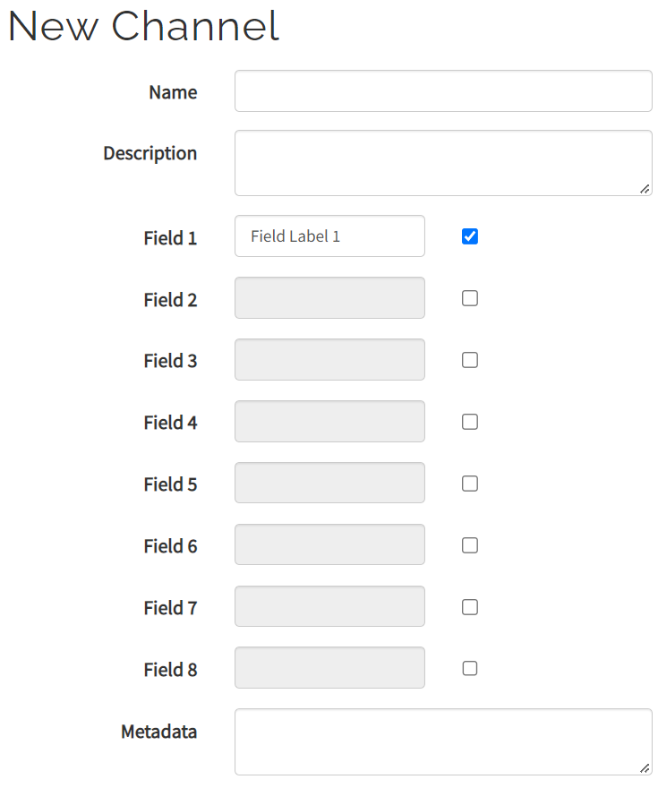
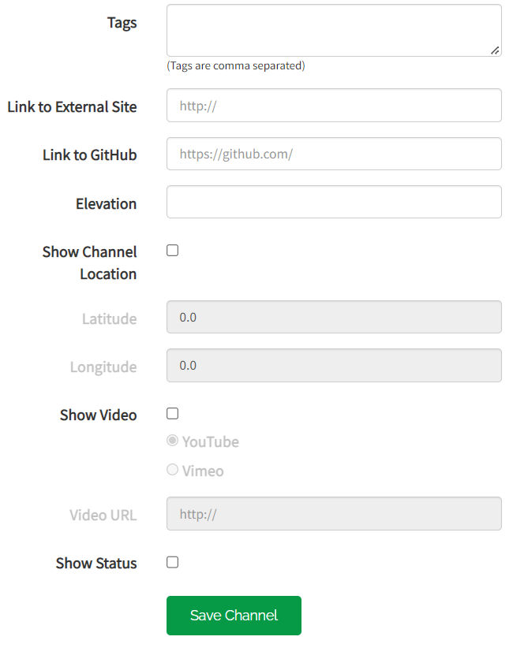
ThingSpeak – New Channel

Slide 7
ThingSpeak – New Channel
Channel Name: Enter a unique name for the ThingSpeak channel.
Description: Enter a description of the ThingSpeak channel.
Field#: Check the box to enable the field, and enter a field name. Each ThingSpeak channel can have up to 8 fields.
Metadata: Enter information about channel data, including JSON, XML, or CSV data.
Tags: Enter keywords that identify the channel. Separate tags with commas.
Link to External Site: If you have a website that contains information about your ThingSpeak channel, specify the URL.

Slide 8
Show Channel Location:
  Latitude: Specify the latitude position in decimal degrees. For example, the latitude of the city of London is 51.5072.
  Longitude: Specify the longitude position in decimal degrees. For example, the longitude of the city of London is -0.1275.
  Elevation: Specify the elevation position meters. For example, the elevation of the city of London is 35.052.
Video URL: If you have a YouTube™ or Vimeo® video that displays your channel information, specify the full path of the video URL.
Link to GitHub: If you store your ThingSpeak code on GitHub®, specify the GitHub repository URL.

Slide 9
ThingSpeak
Ways to Read and Write data in ThingSpeak
REST API (Representational State Transfer Application programming interface)
MATLAB
SIMULINK
MQTT

Slide 10
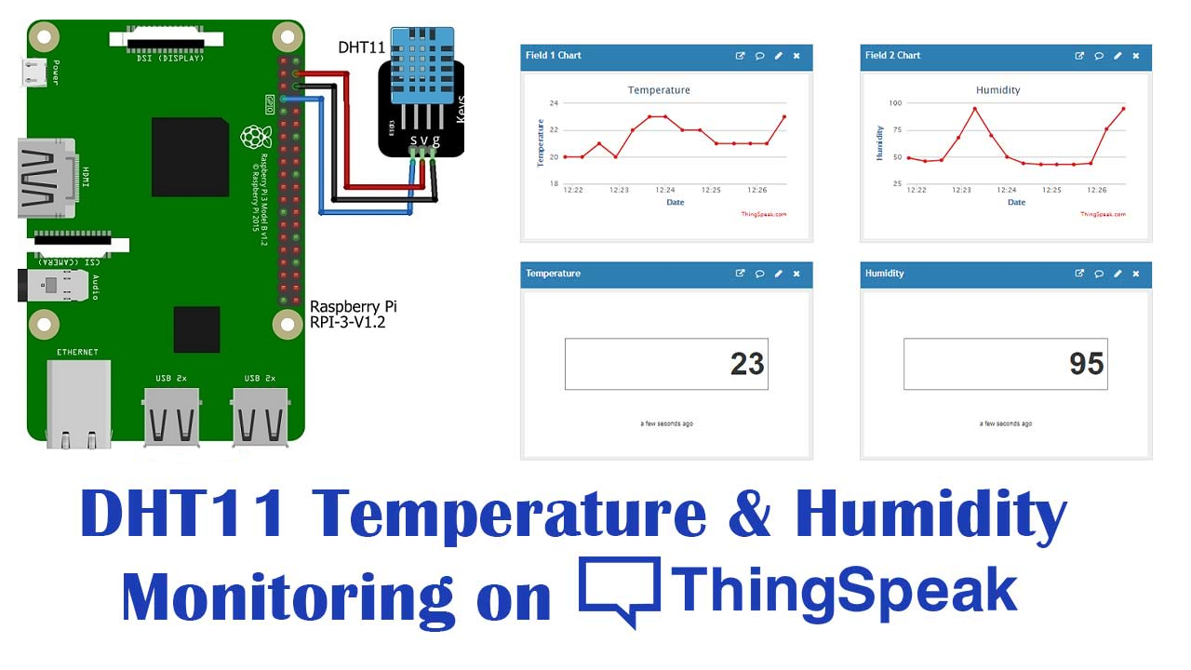
RaspberryPi + DHT11 + ThingSpeak

Slide 11
Lab Work
Creating Account with ThingSpeak Cloud Server
Create channel in ThingSpeak with two different fileds
Connect DHT11 sensor to raspberryPi3 and read the temperature and humidity information and send it to ThingSpeak

Slide 12
Lab Work
Reference:
https://www.iotstarters.com/how-to-send-sensor-data-to-thingspeak-using-raspberry-pi/

